Slide 1
Tax Rates and Corporate Decision Making
John R. Graham (Duke University)
Michelle Hanlon (Massachusetts Institute of Technology)
Terry Shevlin (University of California)
Nemit Shroff (Massachusetts Institute of Technology)
Review of Financial Studies
January 2017
Presented by: Yan Li

Slide 2
Research Question:
What tax rate managers actually use in decision-making settings and whether behavioral factors contribute to some of the puzzles documented in prior research (e.g., the underleverage puzzle in Graham (2000))?

Slide 3
Prior Literature
The marginal tax rate (MTR), defined as the present value of additional taxes paid on an additional dollar of income earned today (Scholes et al. 2014), is the appropriate rate to use to evaluate incremental corporate decisions (MacKie-Mason 1990; Graham 1996a, b; Brealey, Myers, and Allen 2014; and Scholes et al. 2014).
The MTR is correlated with firms’ capital structure decisions (e.g., Graham 1996a; Heider and Ljungqvist 2015).
Some firms appear to follow conservative debt policies given their MTRs (e.g., Graham 2000; Strebulaev and Yang 2013), raising the question of whether managers use the appropriate tax input when making corporate decisions

Slide 4
Survey methodology and sample
A survey instrument with 64 questions was sent to 2,806 companies and 744 usable responses were obtained. After filtering firms such those did not file a corporate income tax return, 500 firms remained in sample.
Survey participants are corporate tax executives

Slide 5
The role of tax executives in organizations
(i) tax planning
(ii) tax compliance (including audits)
(iii) advising and aiding the C-suite and operational functions of the firm
(iv) for the roughly largest 20 to 50 companies, work on tax policy.

Slide 6
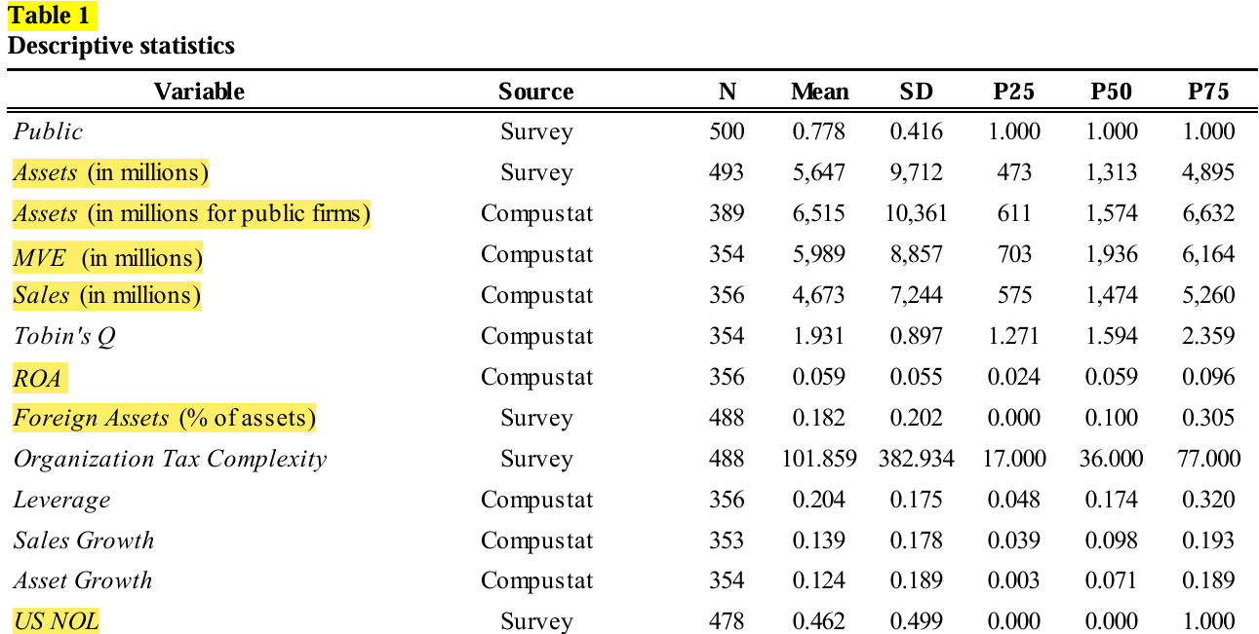
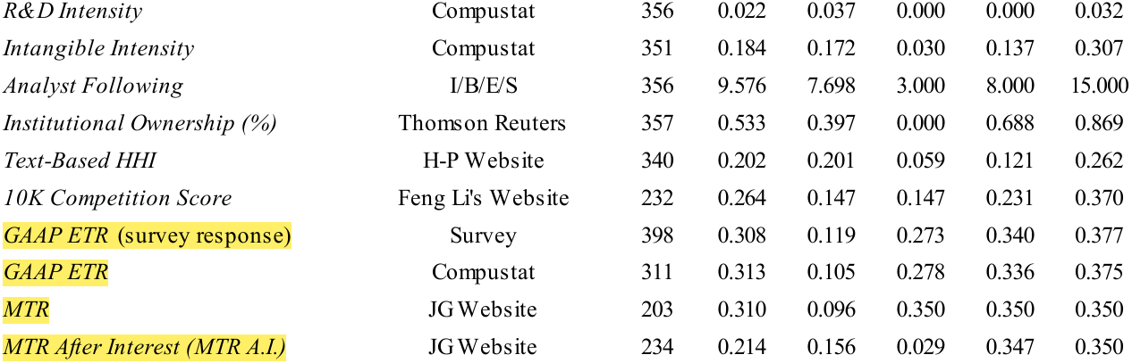
Descriptive statistics and non-response bias tests
Table 1 presents the descriptive statistics of our sample firms for 2006, which was the most recent fiscal year at the time the survey was conducted.

Slide 7
How do managers incorporate taxes into their decisions?
Survey Options: (i) U.S. statutory tax rate, (ii) GAAP effective tax rate, (iii) jurisdiction specific statutory tax rate, (iv) jurisdiction-specific effective tax rate, (v) marginal tax rate, and (vi) other.
Decision Contexts: (i) mergers and acquisitions, (ii) capital structure (debt versus equity), (iii) investment decisions (property, equip., etc.), (iv) the decision to purchase versus lease, (v) weighted average cost of capital, (vi) new facility location and, (vii) compensation.

Slide 8
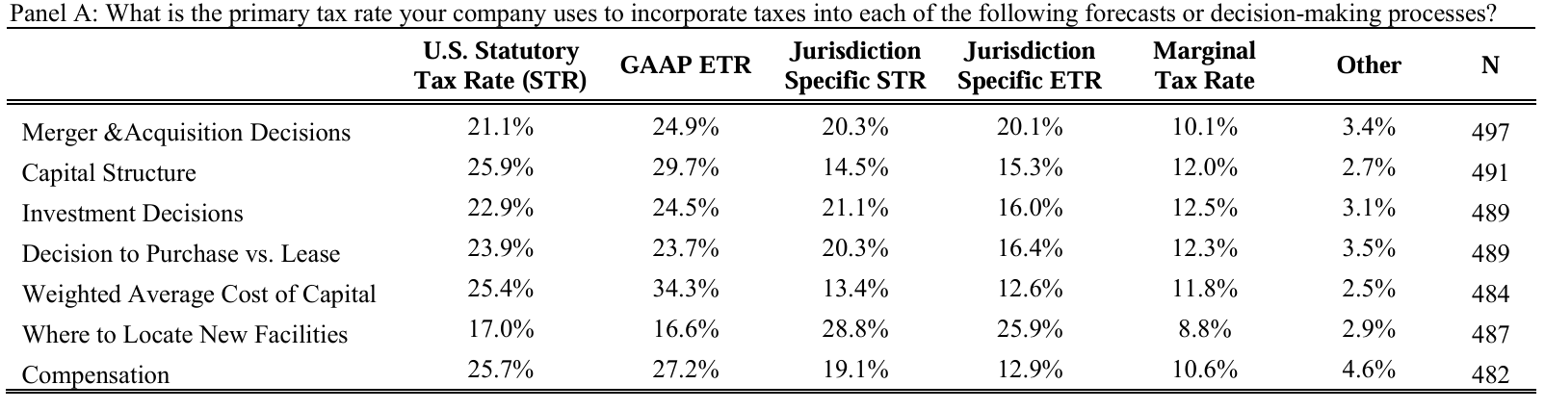
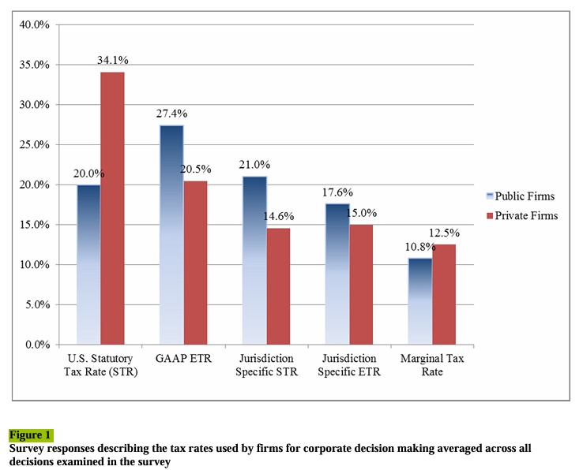
How do managers incorporate taxes into their decisions?
The most popular tax rate managers claim to incorporate into their decision making is the GAAP ETR and the second most popular is the STR.
Very few firms use the MTR
When making location-specific decisions, most managers indicate that they use jurisdiction-specific rates (statutory and effective) as tax input

Slide 9
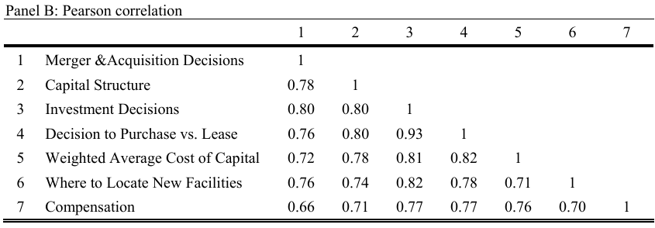
How do managers incorporate taxes into their decisions?
Tax rate choices are highly correlated across different decision contexts (ranging from 0.66 to 0.93). Given the high correlations, for the remainder of our analyses, we focus on firms’ capital structure and investment decisions for brevity and because these are important decisions.

Slide 10
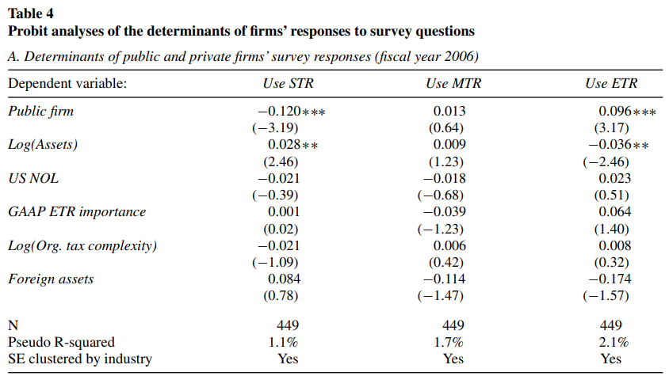
Firm characteristics and the tax rate choice
Public firms are 9.6 percentage points more likely to use the ETR (relative to the STR/MTR) for decision-making.
In contrast, private firms are 12 percentage points more likely to use the STR (relative to the ETR/MTR).
It is consistent with tax rate salience affecting managers’ tax rate choices

Slide 11
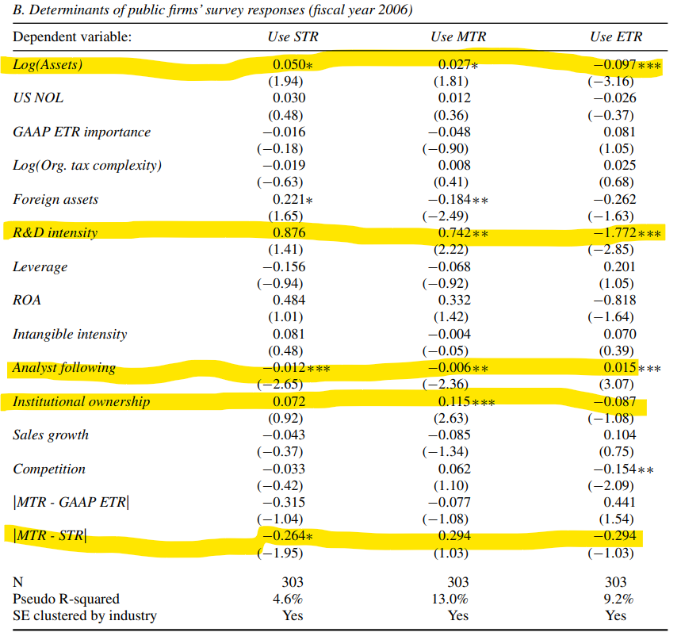
Firm characteristics and the tax rate choice
Larger firms are more likely to use the STR or MTR for decision-making while smaller firms are more likely to use the ETR (consistent with panel A).
R&D-intensive firms are more likely to use the MTR and less likely to use the ETR for decision-making.
firms with larger analyst following are more likely to use the ETR and less likely to use the STR and MTR for decision-making
firms with high institutional ownership and firms operating in environments with greater product market competition are more likely to use the MTR and less likely to use the ETR for decision-making, respectively
firms are less likely to use the STR for decision-making when the difference between the MTR and STR is larger: a ten percentage point increase in the difference between the MTR and STR reduces the likelihood of using the STR by 2.6 percentage points

Slide 12
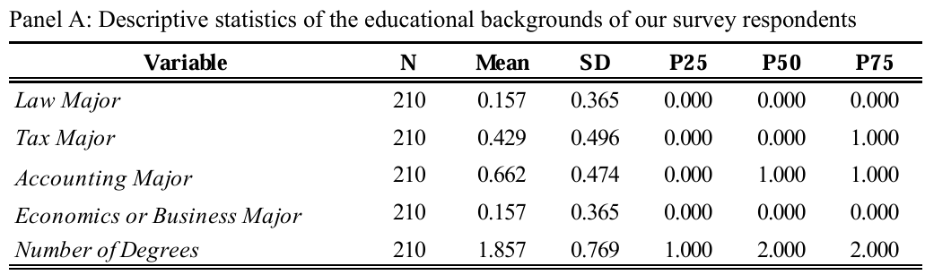
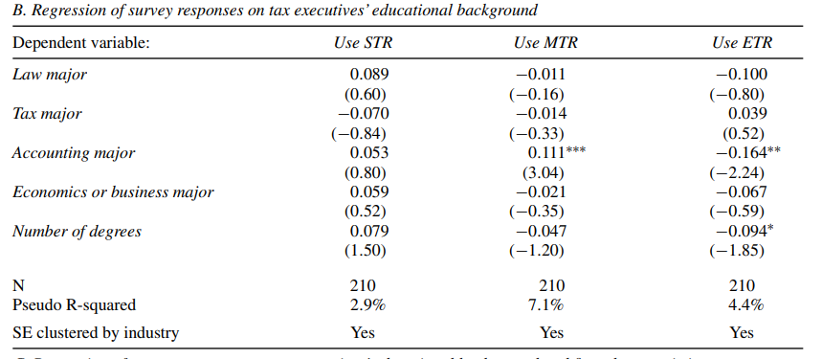
Executive educational background and tax rate choice
tax executives with at least one accounting degree are more likely to use the MTR and less likely to use the ETR
more educated tax executives, proxied by number of degrees, are less likely to use the ETR for decision making

Slide 13
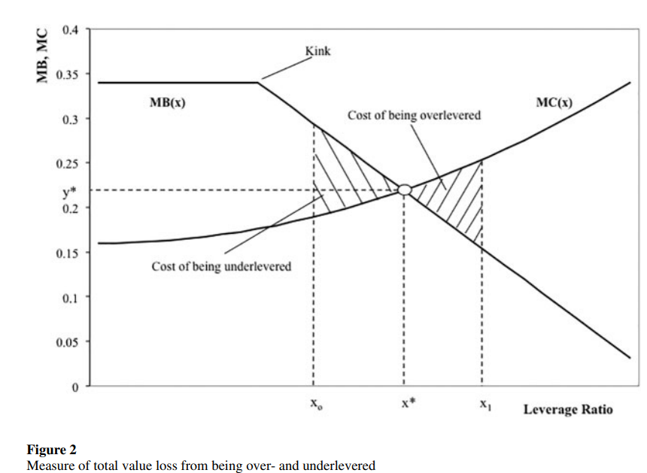
Capital structure consequences of tax rate choices
Do firms that use the ETR in capital structure decisions make suboptimal choices?
Kink: the marginal tax benefits of debt begin to decline
“optimal” or “equilibrium” leverage ratio: the intersection of the marginal benefit and cost curves
Equilibrium factor = the model-predicted-optimal-leverage ratio / the firm’s observed leverage
An Equilibrium factor of 1.2 (0.8) implies that the firm’s optimal leverage ratio is 20% larger (smaller) than its actual leverage ratio and the firm is underlevered (overlevered)

Slide 14
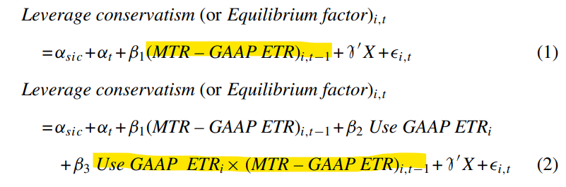
Capital structure consequences of tax rate choices
Do firms that use the ETR in capital structure decisions make suboptimal choices?
i: indexes firms
t: indexes years,
α_{sic &}α_{t} : industry and year fixed effects,
X: a vector of control variables that includes a number of nontax factors that affect debt policy.
Equation (1) is estimated on the sample of firms that use ETR in their capital structure decisions
Equation (2) is estimated on the sample of firms that use ETR in their capital structure decisions and a matched sample of firms that use the MTR/STR in their capital structure decisions

Slide 15
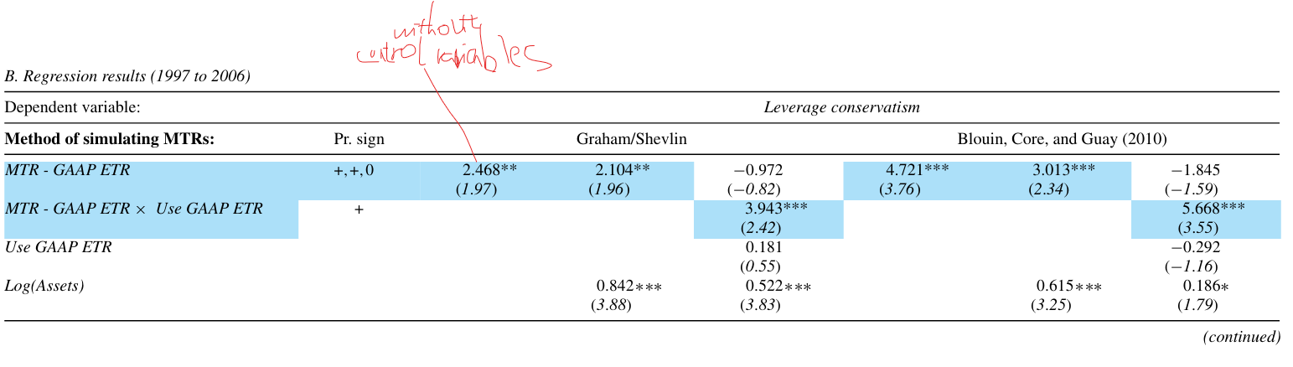
Capital structure consequences of tax rate choices
Positive and significant coefficients suggest that as the difference between a firm’s MTR and ETR widens such that the firm’s ETR is higher (lower) than its MTR, the firm adopts a relatively aggressive (conservative) debt policy
The coefficients for Use GAAP ETR and MTR – GAAP ETR in equation 2 are statistically insignificant, suggesting that the MTR versus ETR wedge is associated with the debt policy of firms that use the ETR for decision-making but there is no such association between the MTR versus ETR wedge and debt policy of firms that use the STR and MTR
Firms using the ETR for decision-making make capital structures decisions similar to firms using the STR/MTR for decision-making when MTR – GAAP ETR is zero

Slide 16
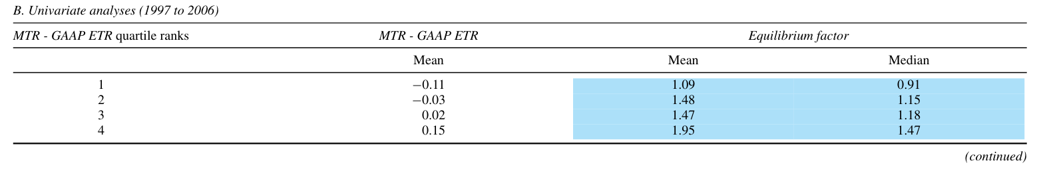
Capital structure consequences of tax rate choices
Do firms that use the ETR in capital structure decisions make suboptimal choices?
a near monotonic increase in Equilibrium factor as we move from the first to the fourth quartile of MTR – GAAP ETR
the median firm in the 1st quartile of the MTR – GAAP ETR distribution is over-levered but the median firm in the remaining three quartiles is under-levered. Lower GAAP ETR, more conservative.
firms using the ETR for capital structure decisions become more under-levered as MTR becomes larger than the ETR, consistent with our prediction.

Slide 17
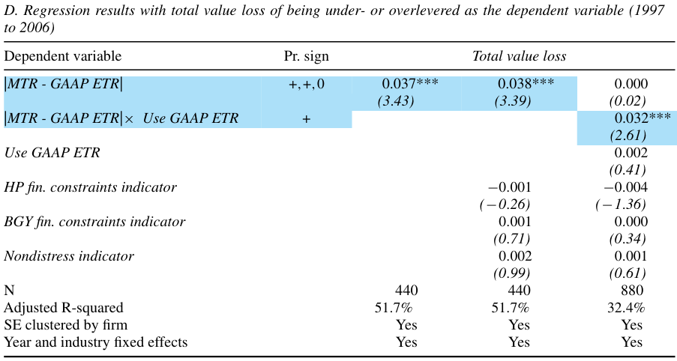
Capital structure consequences of tax rate choices
Do firms that use the ETR in capital structure decisions make suboptimal choices?
The coefficient for |MTR – GAAP ETR|× Use GAAP ETR suggests that a one-percentage-point increase in the MTR versus ETR wedge increases Total value loss by 0.032 percentage points.
Considering that the average firm that uses the ETR has a MTR versus ETR wedge of 7.7%, our regression coefficient implies that a firm that uses the ETR for capital structure decisions incurs a loss of 0.25% of its book value of assets, which amounts to $16 million (in terms of 2006 dollars) from making suboptimal capital structure decisions.

Slide 18
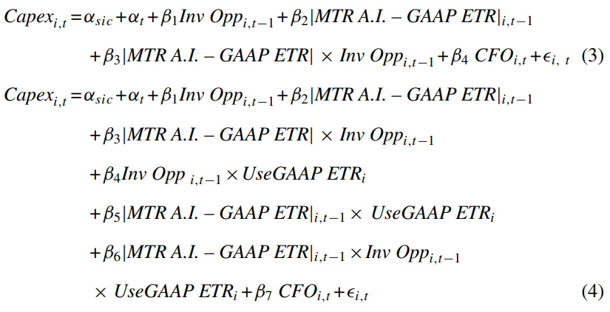
Capital investment consequences of tax rate choices
Prediction: if a firm’s ETR is higher (lower) than its MTR and the ETR is used for decision-making, such a firm is likely to underestimate (overestimate) the after-tax cash flows from investing and thus underinvest (overinvest).
The first is estimated over firms that use the ETR and the second is estimated over firms that use the ETR and a matched sample of firms that use the MTR/STR

Slide 19
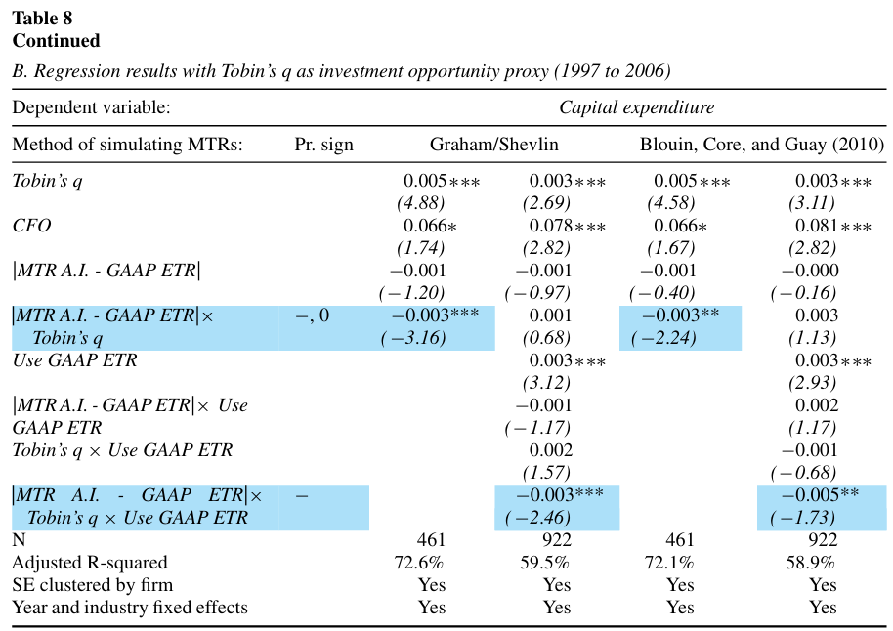
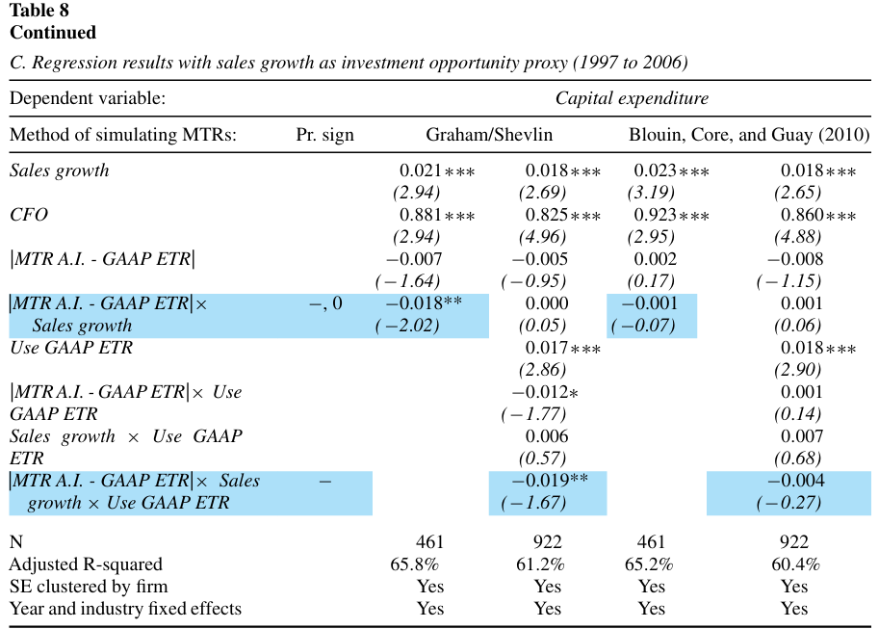
Capital investment consequences of tax rate choices
The estimated coefficients for |MTR A.I. – GAAP ETR|× Inv Opp and |MTR A.I. – GAAP ETR|× Inv Opp × Use GAAP ETR are negative and significant in six of eight specifications, suggesting that as the gap between a firm’s MTR and ETR widens, firms that use the ETR as the tax rate input for investment decisions become less responsive to their growth opportunities

Slide 20
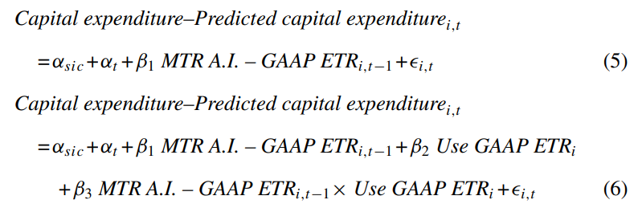
Additional Test _ Capital investment consequences of tax rate choices
Predicted capital expenditure for each firm-year is used as a proxy for optimal investment, assuming that financially unconstrained firms make optimal investment decisions on average

Slide 21
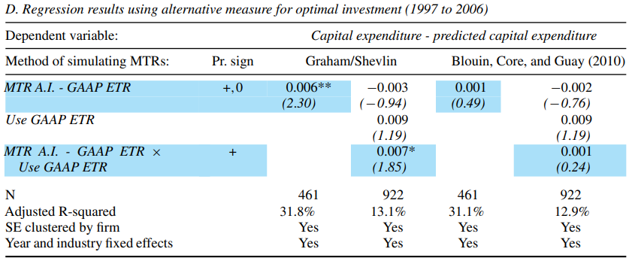
Additional Test_Capital investment consequences of tax rate choices
the coefficients for MTR A.I. – GAAP ETR and MTR A.I. – GAAP ETR × Use GAAP ETR are positive in all regressions and statistically significant in 2 of 4 regressions (these coefficients are not significant when MTRs are measured using the BCG approach), indicating that the efficiency of investment decreases with the MTR versus ETR wedge for firms that use the ETR as tax input

Slide 22
Conclusions
Many firms use the GAAP effective tax rate and the U.S. statutory tax rate as tax rate input and few firms use the marginal tax rate
The difference between the STR and MTR is less than two percentage points for the vast majority of firms that use STR as the tax rate input for decision making, a result that is consistent with managers relying on simple heuristics in their decision-making process.
Evidence consistent with a behavioral salience effect: Public firms are significantly more likely to use the GAAP ETR as tax rate input while private firms are more likely to use STRs in their decisions
Firms using ETRs as the tax rate input for capital structure decisions adopt an aggressive (conservative) debt policy when their ETR is greater (less) than their MTR, costing the average firm $16 million (in 2006 dollars) in forgone value
Firms that use the ETR as the tax rate input for investment decisions are less responsive to investment opportunities when the difference between their firm’s MTR and ETR is large.

Slide 23
Marginal Contributions to Literature
Contributes to the literature in psychology and behavioral economics that finds that agents often deviate from decision rules predicted by standard models, which assume agents optimize perfectly.
contributes to the literature by providing further evidence that there is an association between taxes and corporate decisions, such as leverage and investment; associations that have drawn skepticism at times (e.g., Li, Whited, and Wu 2015).
our paper responds to Baker and Wurgler’s (2013) call for research to examine whether behavioral biases help explain why managers do not more aggressively pursue the tax benefits of debt: We show and provide a lower bound estimate of the negative economic effects from managers using the ETR in their decisions.

